Slide 1
Evolution over time of the structure of social graphs
Student Leonardo Serilli
Supervisors Nicolas Nisse, Malgorzata Sulkowska, Frédéric Giroire
Year 2021/2022

Slide 2
Data
01
STATE OF THE ART
02
DEGREE DISTRIBUTION
DATA PREPARATION
TABLE OF CONTENTS
04
03
VERTEX TRAJECTORIES
05
06
NEXT STEPS
Scale-free networks
Vertex trajectories
Theoretical model
Degree Distribution Retrieval
Degree Distribution Fitting
Which researchers should be taken into account?
How to interpret a time step?
Average Trajectories
Stretching
Fitting Trajectories
General Fitting

Slide 3
01
DATA

Slide 4
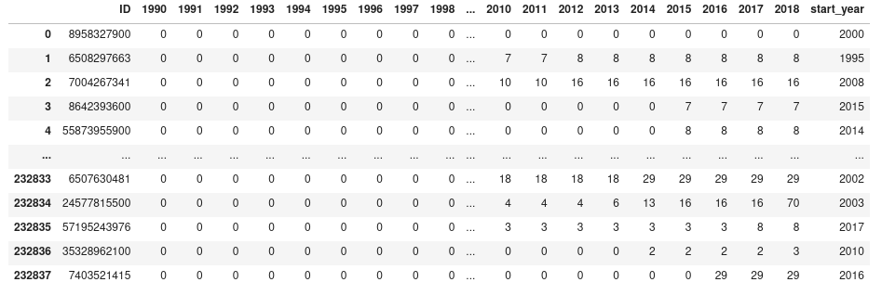
COLLABORATION DATA
The following data is about the total number of collaborations for computer science authors in France since 1990 to 2018.

Slide 5
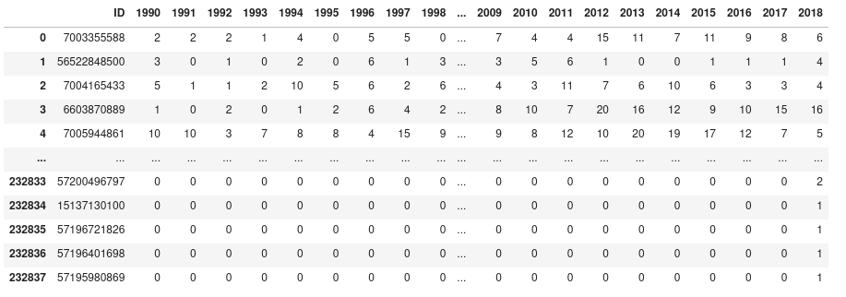
PUBLICATION DATA
The following data is about the number of publications in each year, for computer science authors in France since 1990 to 2018.

Slide 6
02
STATE OF THE ART
Scale-free networks
Vertex trajectories
Theoretical model

Slide 7
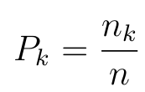
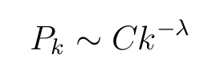
SCALE-FREE NETWORKS
Let:
G = (V, E) be a graph of n nodes.
n_k be the #nodes of degree k in G,
λ > 0 an exponential parameter,
C > 0 a scaling constant.
The degree distribution P_k of G follows a power-law if:
and
A network whose probability distribution of degrees of nodes respects the power law distribution is said to be scale-free.

Slide 8
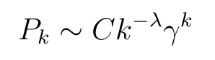
SCALE-FREE NETWORKS
Scale-free networks are not so widespread as thought, it turns out that many of them follow a power-law distribution with an exponential cut-off:
where 0 ≤ γ < 1 is a constant parameter of the distribution.
The experimental study showed that data we are working with also falls into ”exponential cutoff” case.

Slide 9
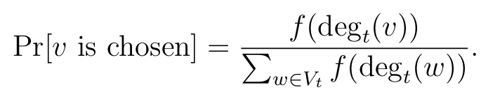
VERTEX TRAJECTORIES
Given a graph G_t = (V_t , E_t ), where t is a given time step are defined:
Node Event: a new node appears in the graph,
Edge event: a new edge appears.
New nodes and edges must select already present nodes to attach. The probability for any node v to be chosen is defined from an attachment function f(x):
Where deg_t(v) is the degree of vertex v at timestep t .

Slide 10
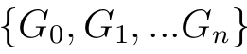
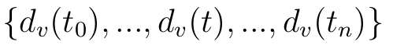
VERTEX TRAJECTORIES
Given n time steps, defined by the occurrence of an event, the evolution of a graph G_0 is the sequence:
Let:​
d_v(t) degree of vertex v at timestep t,​
t_0 timestep in which v appears.
​
=> The vertex trajectory of v is the evolution over time of it’s degree, so the sequence:

Slide 11
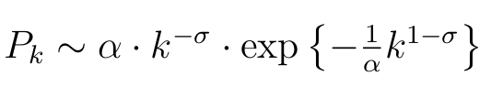
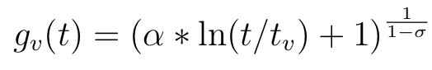
THEORETICAL MODEL
Given:
α > 0,
0 ≤ σ < 1,
t_v be the time step in which v join the network ,
f(x) = x^σ is the attachment function; this time is sublinear, which gives power-law with exponential cutoff (so far we used linear and constant functions, but they give normal power-law). This produces logarithmic vertex trajectory. We will check whether they fit our real data.
The theoretical model, referred from now on, is the one illustrated next, in which: the degree distribution P_k follows a more subtle distribution than the power-law with exponential cut-off, the so-called stretched exponential:
and the vertex trajectory has logarithmic shape:

Slide 12
03
FACED PROBLEMS
Which researchers should be taken into account?
How to interpret a time step?

Slide 13
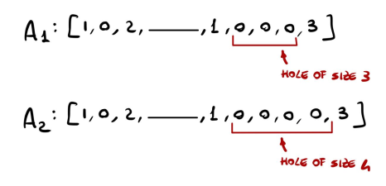
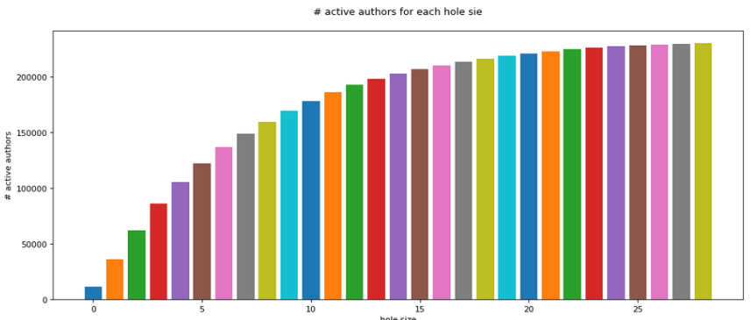
Which researchers should be taken into account?
An author has a hole of size n ∈ N , in his publication history, if he stopped to publish for n consecutive years.
Follow that the maximum hole size is the maximum number of years he has passed without publishing.
An author is inactive for a given hole size if he has a hole, in his publication data, greater than the given hole sizes.
For each possible hole size, has been built a dataset where all authors considered inactive have been filtered out.

Slide 14
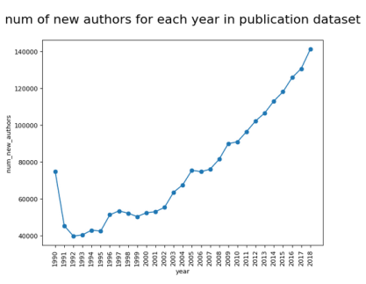
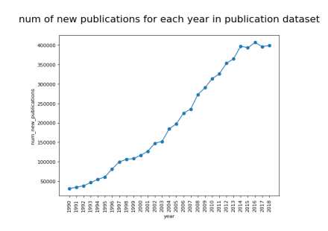
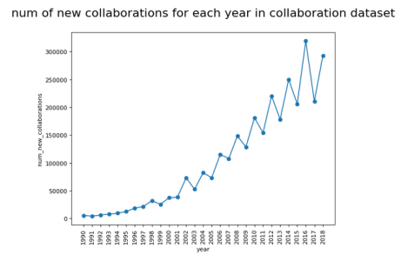
How to interpret a time step?
The theoretical model, as a time step, consider events, so the set of year, containing only 28 time step, can be too small in order to build meaningful vertex trajectories.
Other metrics are so considered as event : the occurrence of a new publication, of a new author or a new collaboration.
This results in a stretching of the vertex trajectories, which shows the logarithmic shape described in the theoretical model

Slide 15
04
DEGREE DISTRIBUTION
Degree Distribution Retrieval
Degree Distribution Fitting

Slide 16
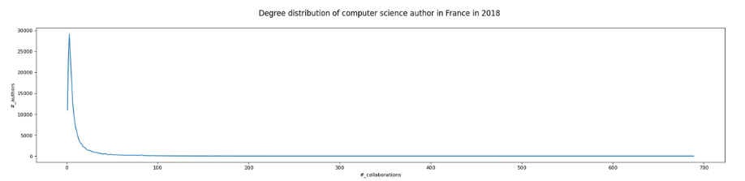
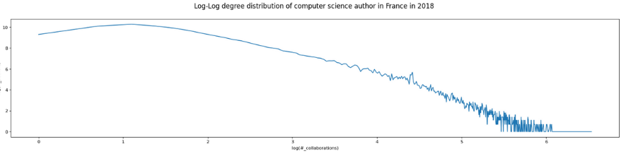
DEGREE DISTRIBUTION RETRIEVAL
To acquire more knowledge from the character of the data the degree distribution is found, taking the #authors with a given #collaborations. ​

Slide 17
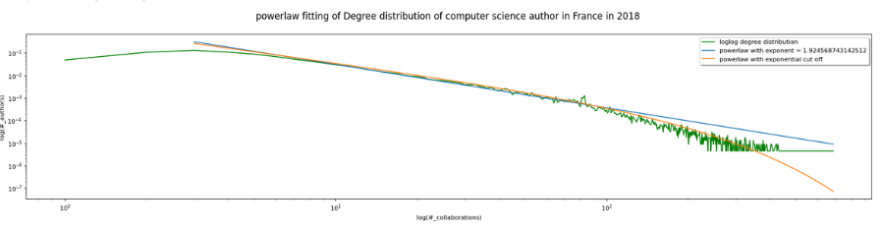
DEGREE DISTRIBUTION FITTING
Fitting the given distribution with the power-law, both the classic and the one with exponential cut-off.
Results that a power-law with exponential cut-off is better for it's fitting. ​

Slide 18
05
VERTEX TRAJECTORIES
Average Trajectories
Stretching
Fitting Trajectories
General Fitting

Slide 19
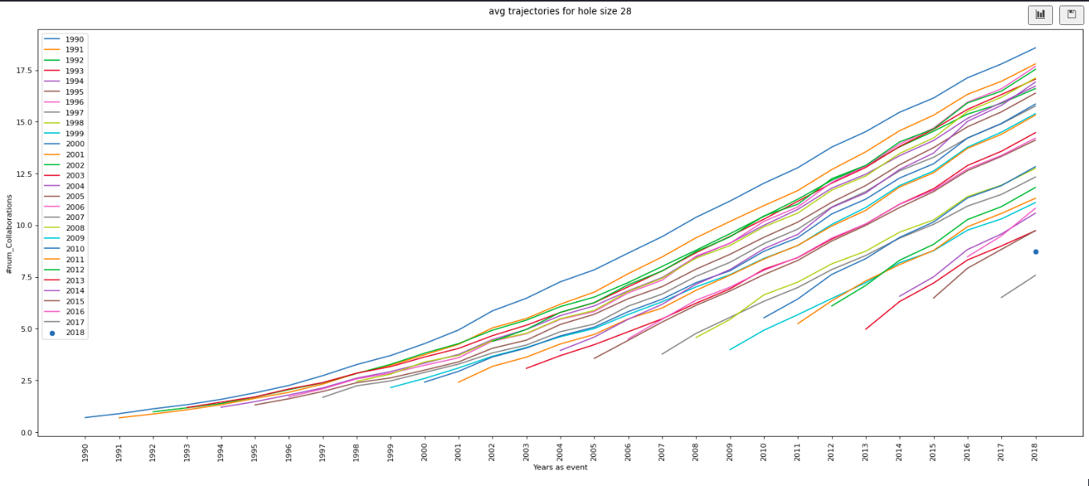
AVERAGE TRAJECTORIES
In order to refer to the theoretical model described in the state of the art, is computed and plotted the average trajectory of authors by starting year.

Slide 20
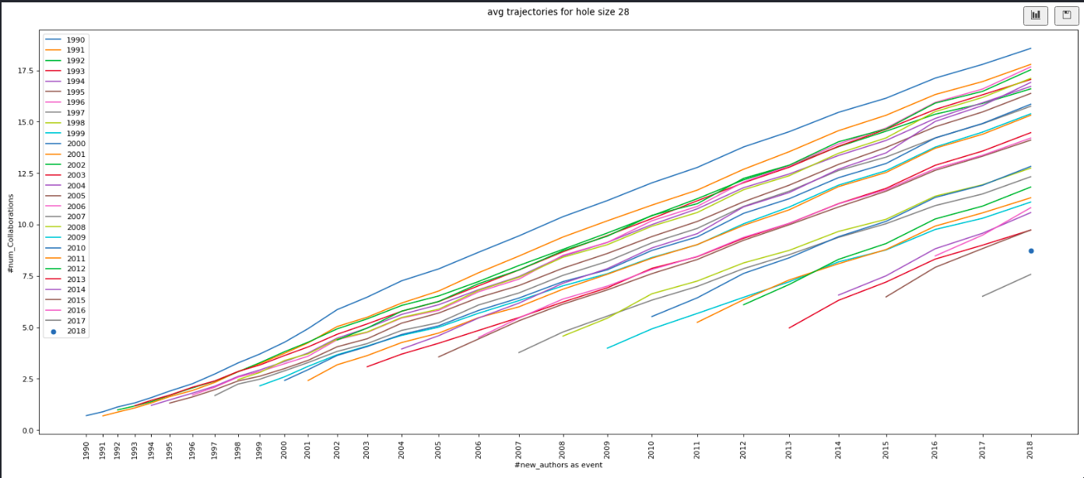
STRETCHING
Trajectories are stretched considering the number of new authors as event.

Slide 21
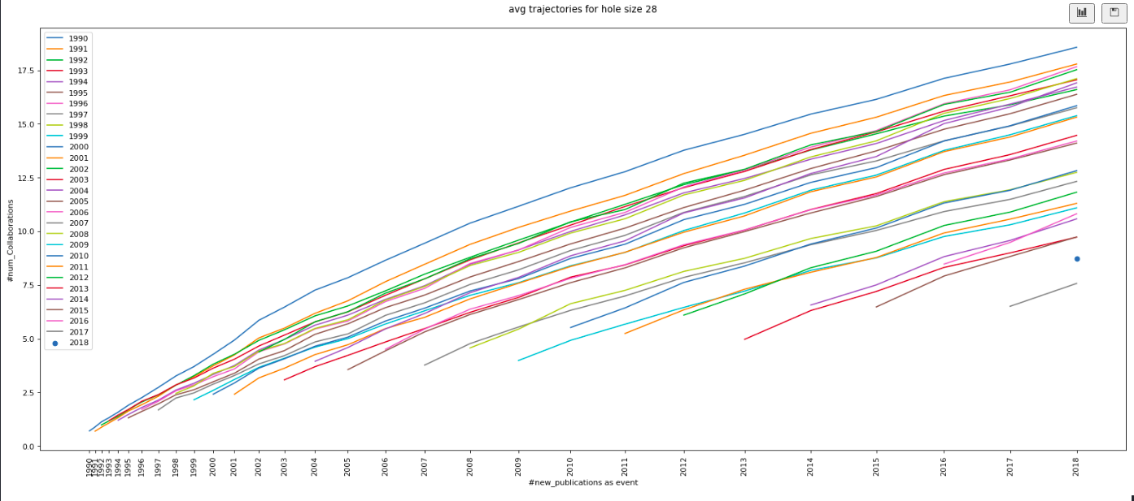
STRETCHING
Trajectories are stretched considering the number of new publications as event.

Slide 22
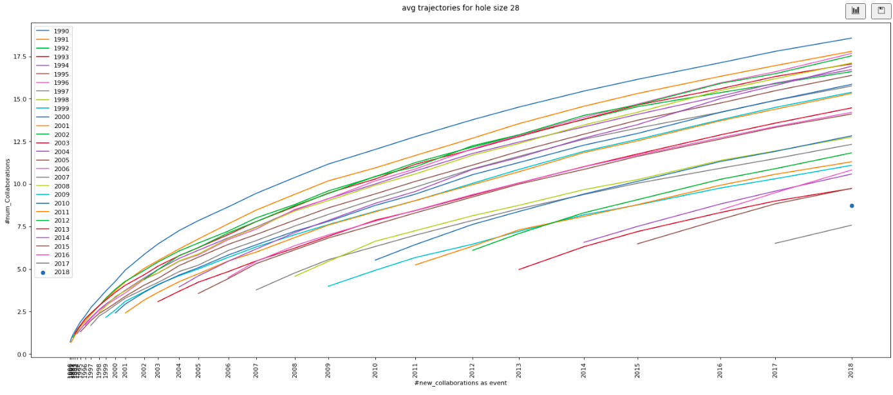
STRETCHING
For the fitting presented in the next section, is considered the number of new collaborations as event, representing better the logarithmic shape of the theoretical model. ​

Slide 23
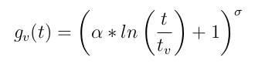
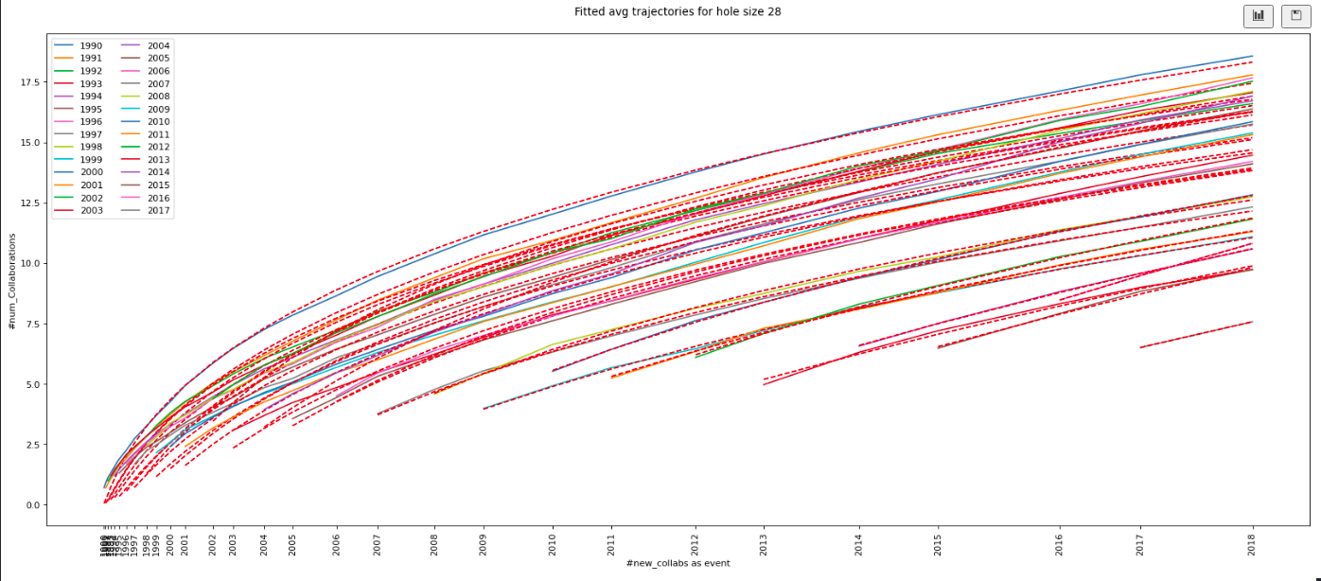
FITTING TRAJECTORIES
Average trajectories are fitted one by one using the logarithmic function representing the theoretical vertex trajectory.
The fitting works better for trajectories with a low starting year, they contain enough data to show the logarithmic behavior we are trying to fit.

Slide 24
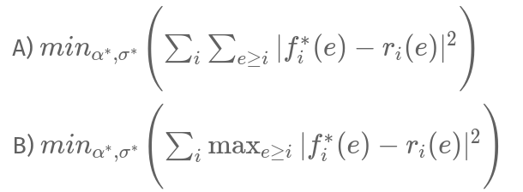
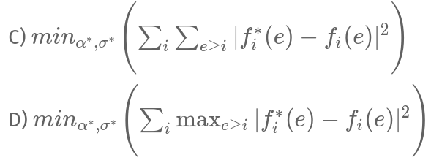
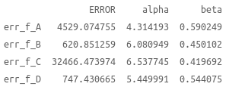
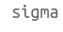
GENERAL FITTING
Then has been tried to find the best couple of parameters α and σ able to fit all curves minimizing the total error on the fitting, for four different kind of error, and obtaining so four couples of optimal parameters.
Given a starting event i and a generic event e:
- r_i(e) is the real average trajectory for authors who started to publish at the event i;
- f_i(e) is the fitting function associated with r_i(e);
- f_i^*(e) is the general fitting function of which we want to optimize the parameters, for authors who started to publish at the event i.

Slide 25
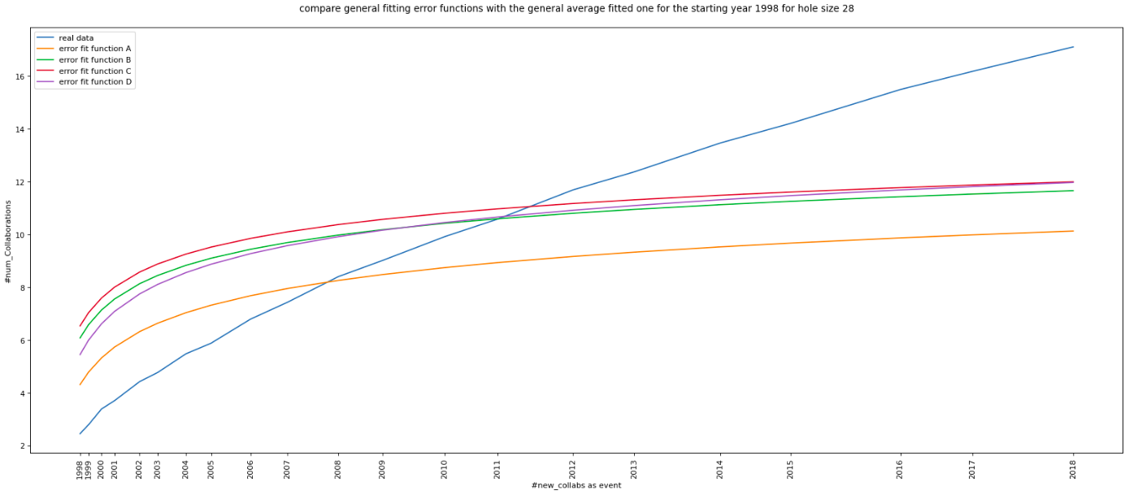
GENERAL FITTING

Slide 26
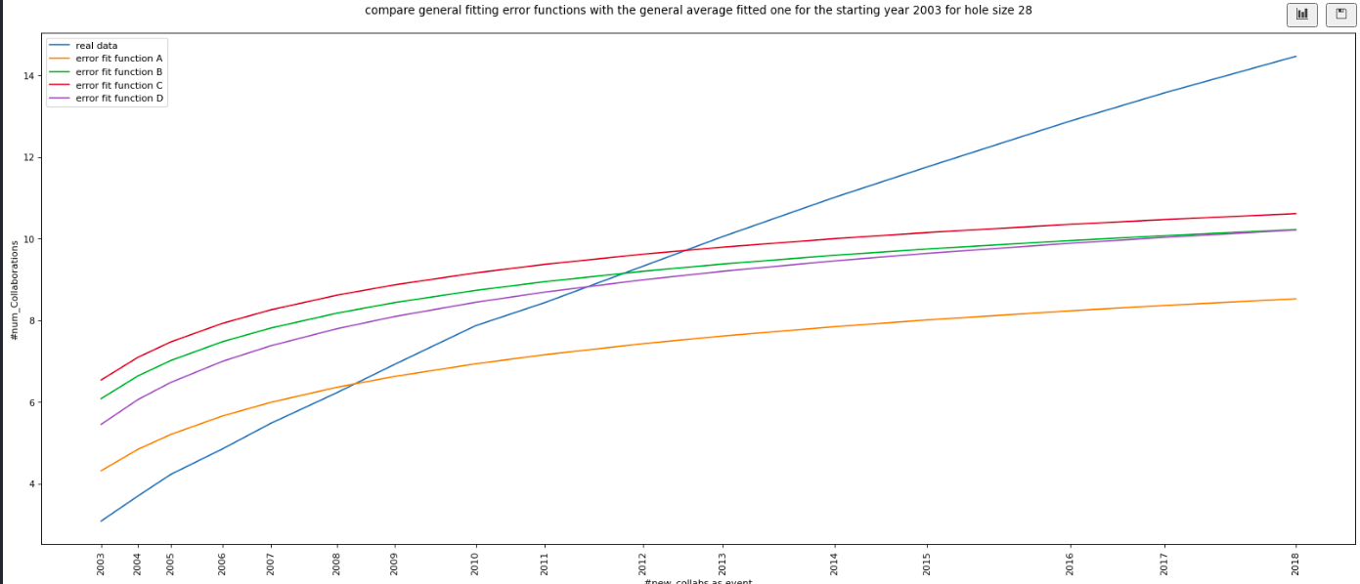
GENERAL FITTING

Slide 27
06
NEXT STEPS

Slide 28
NEXT STEPS
The underlying theoretical model is probably more complex than we assumed at the beginning
Next step: the analysis of data from other research field.
Next step: two subset of authors ,granted and non-granted, with similar trajectories up to the year of the grant; comparing trajectories of granted who started at the same time with their controls

Slide 29
